Slide 1


Data analysis : Sales Data
Data-Driven Storytelling Presentation:
Data-Driven Insights on Account Sales Performance
An Analysis of Year-over-Year Growth and Marketing Effectiveness
Sukhveer Singh

Slide 2

Introduction:
We have summarized this dataset and analyzed following:
Reviewing annual unit sales figures for each of the past five years.
Distinguishing the account types that have outperformed others in terms of unit sales.
Top 10 CAGR
Best Marketing campaign

Slide 3
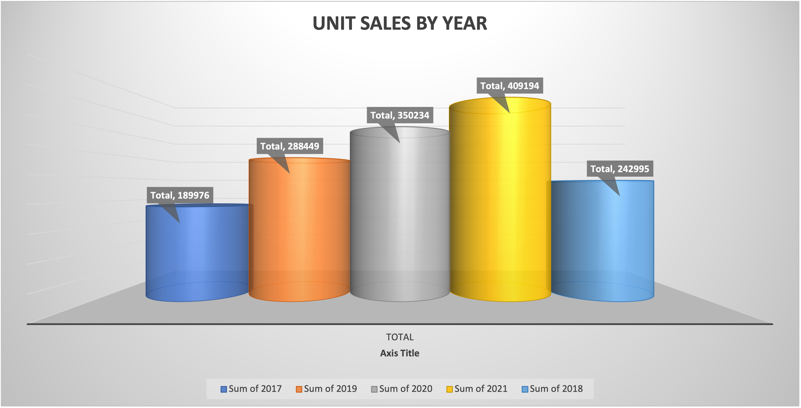
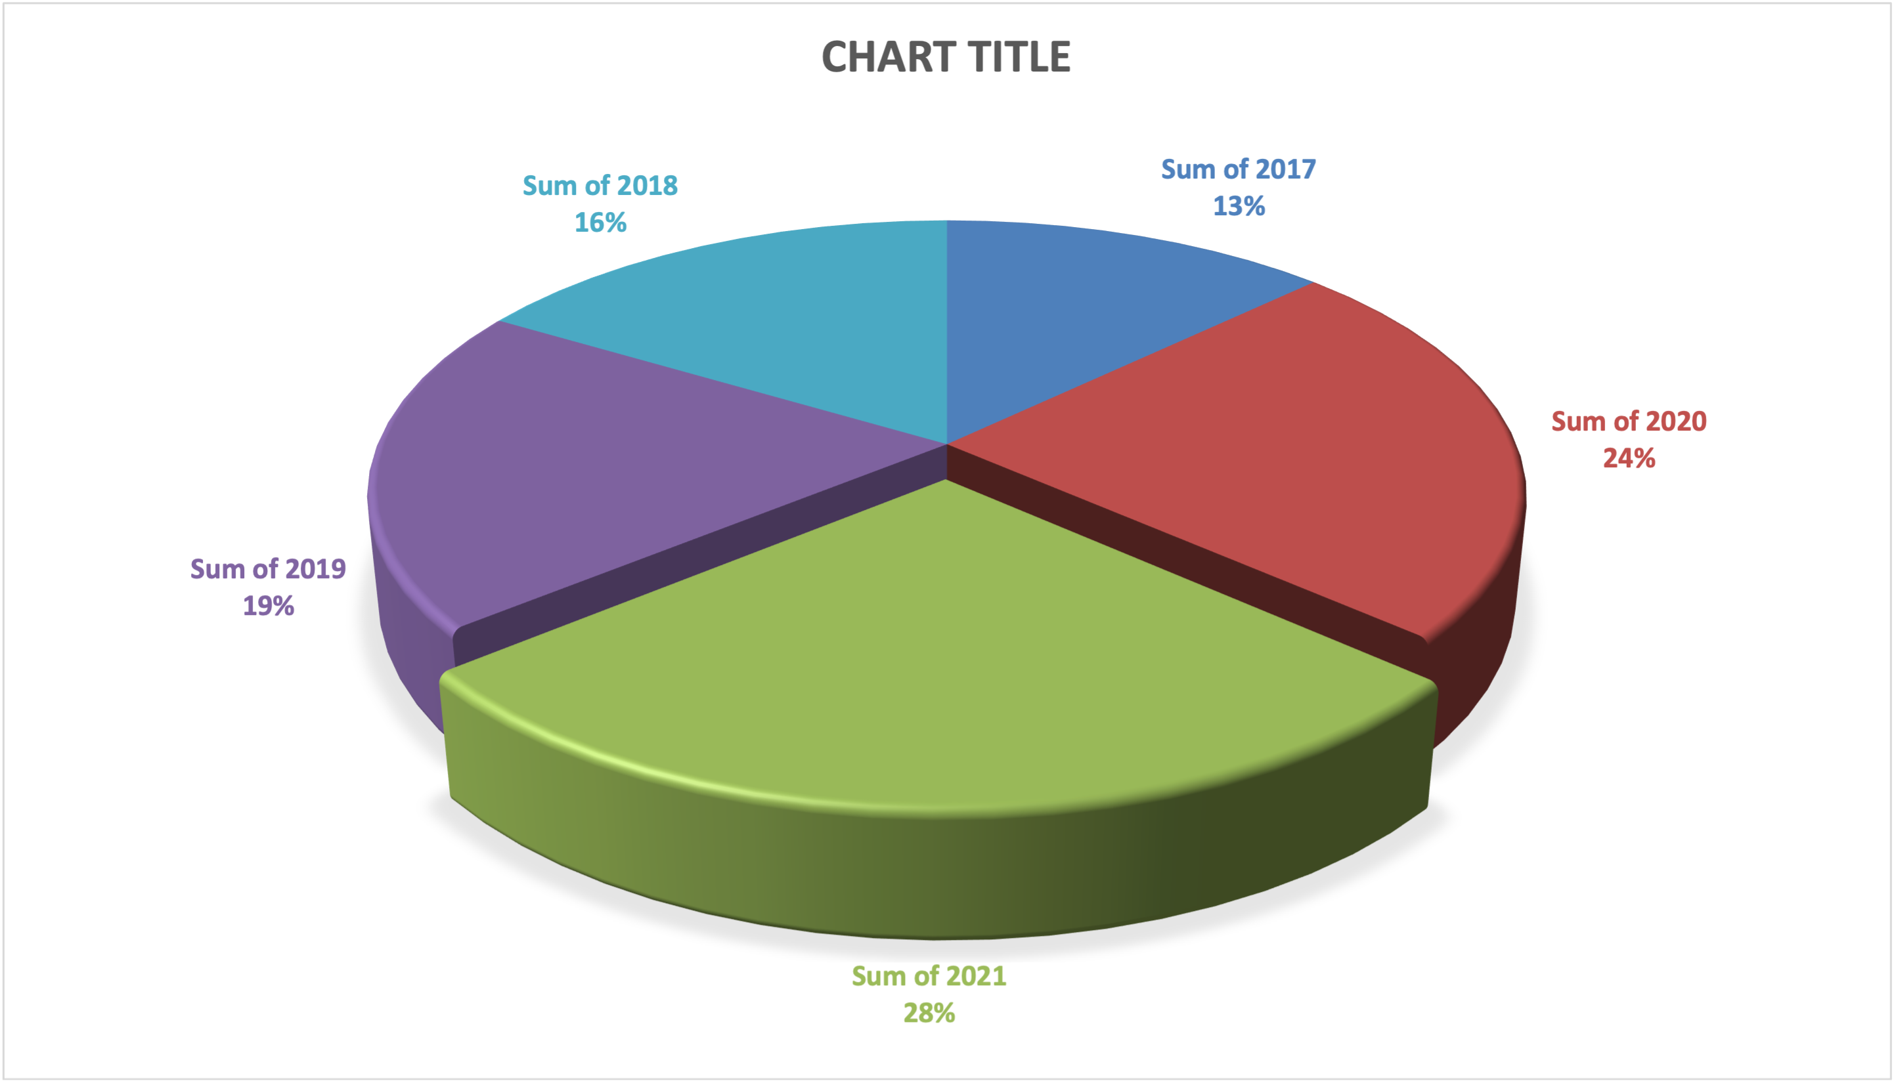
Reviewing annual unit sales figures for each of the past five years.

Slide 4
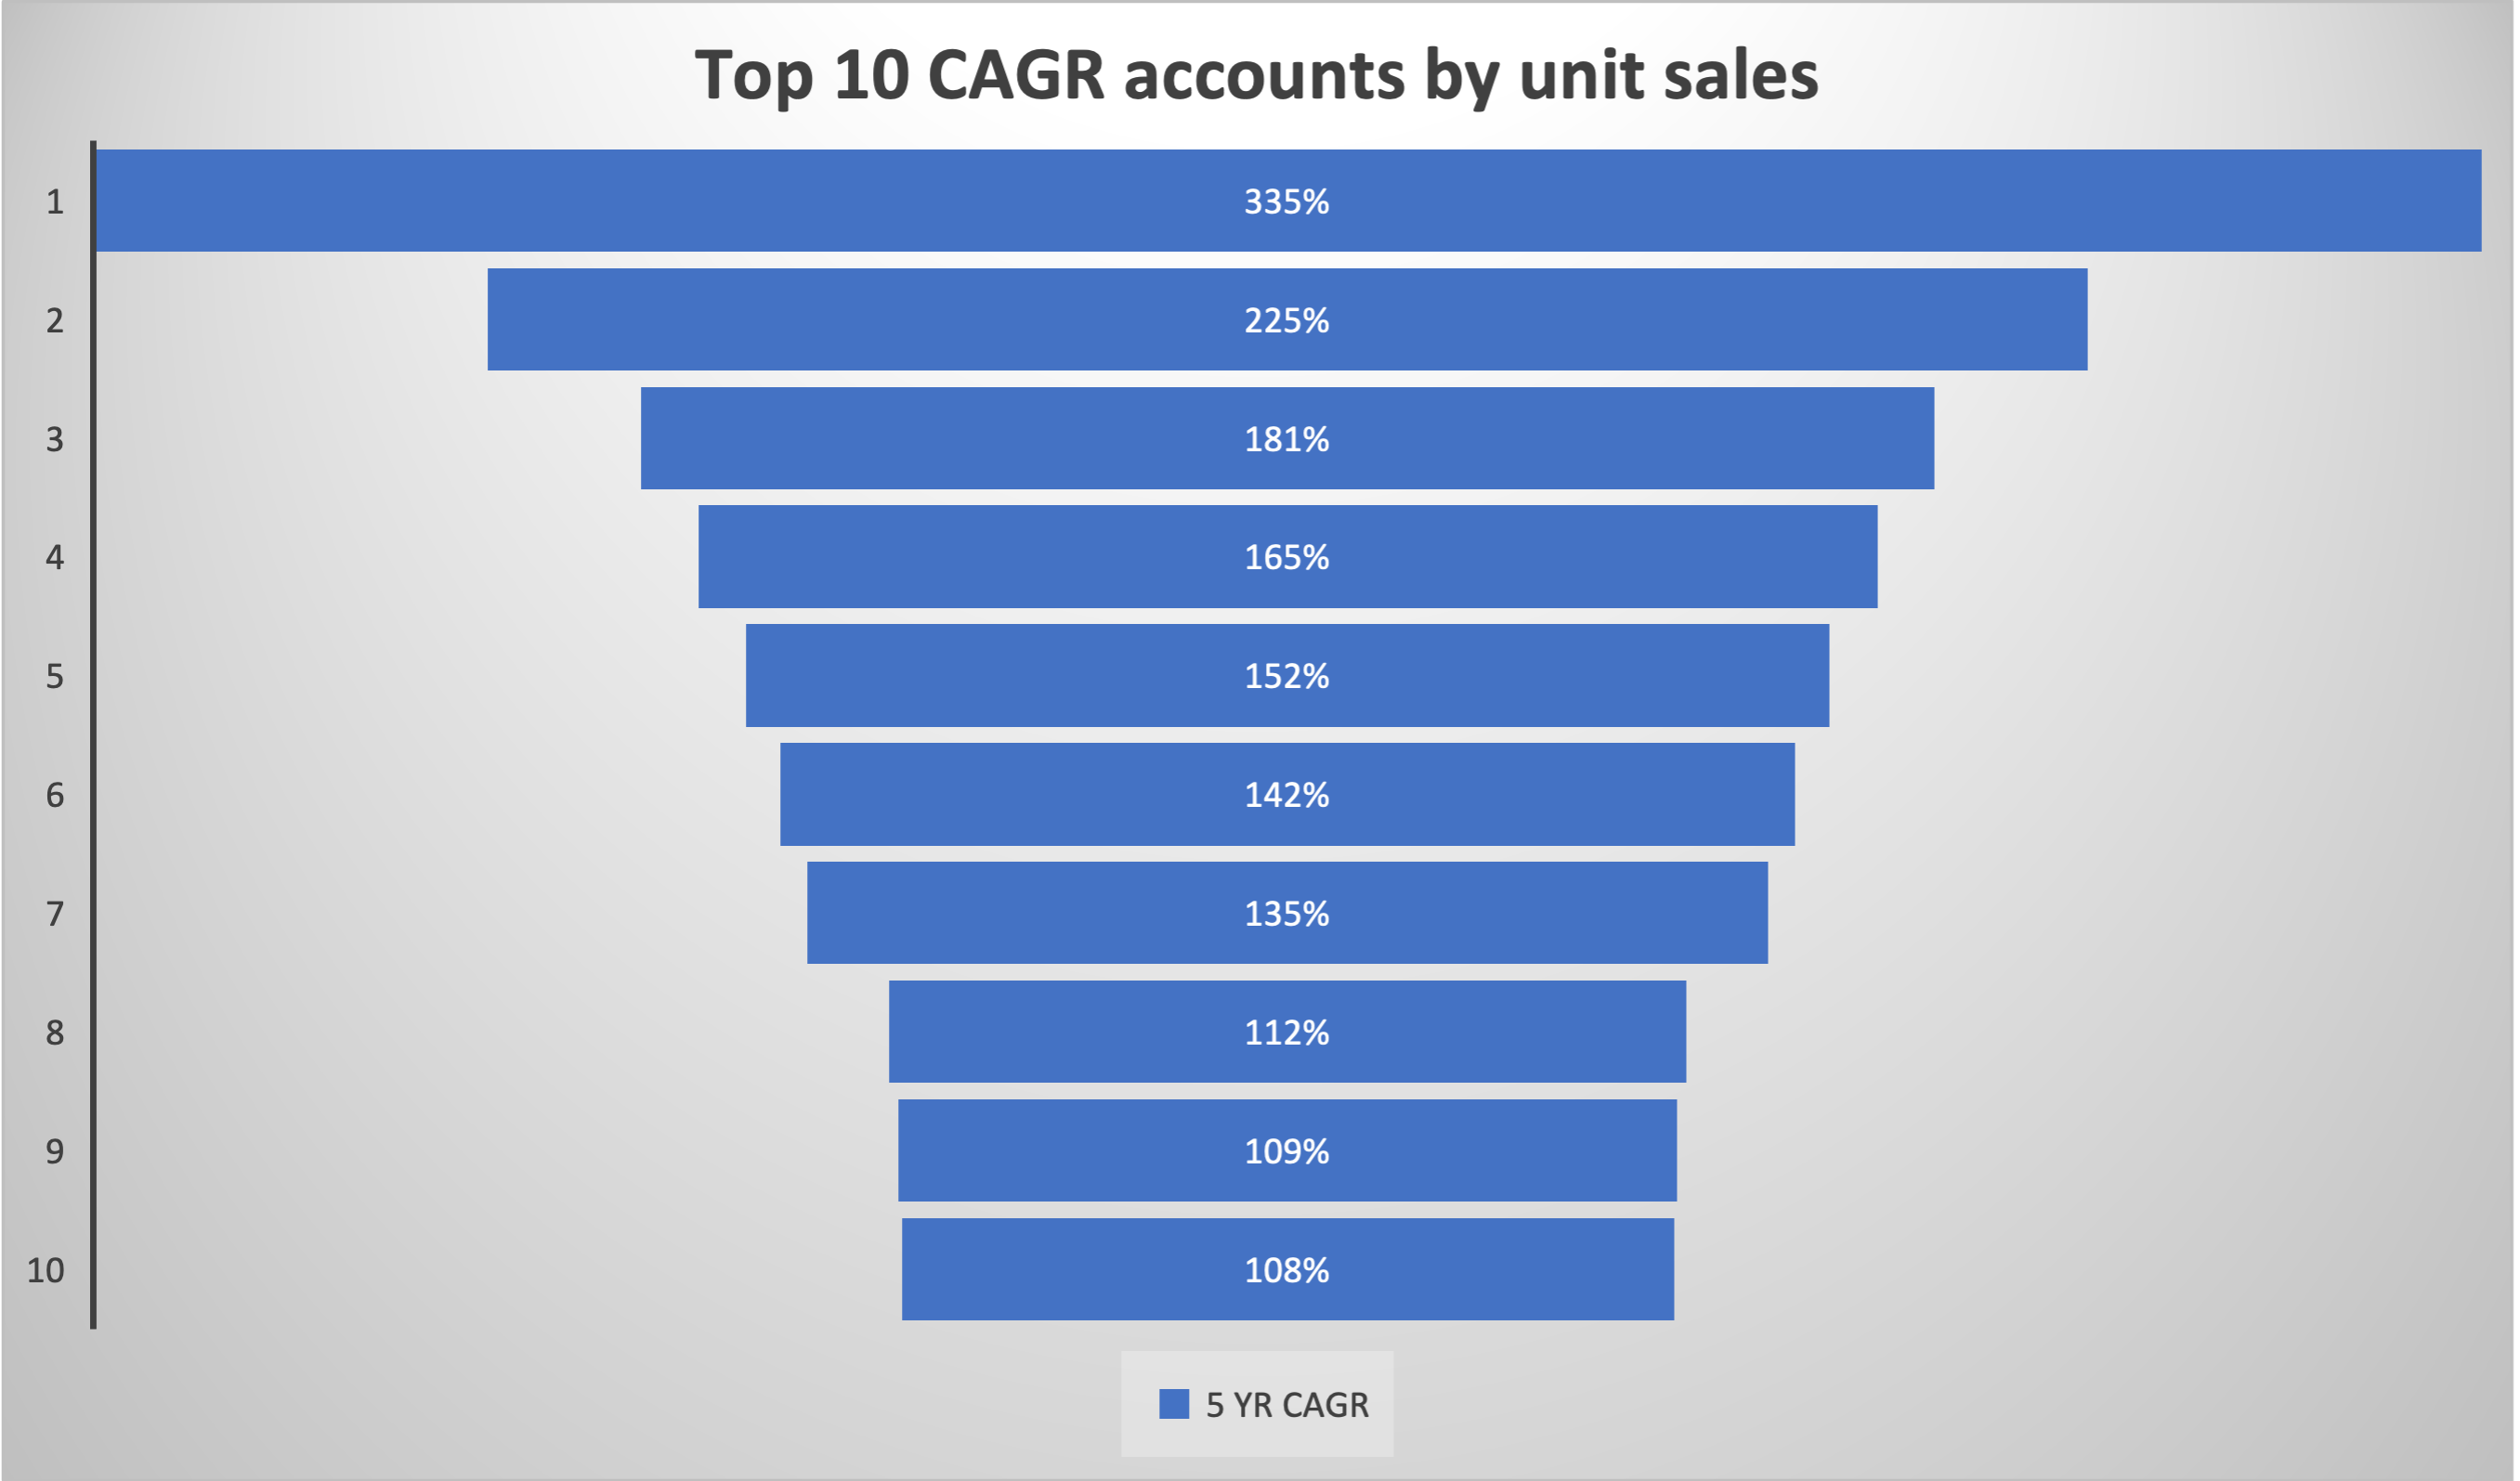
Top 10 CAGR

Slide 5

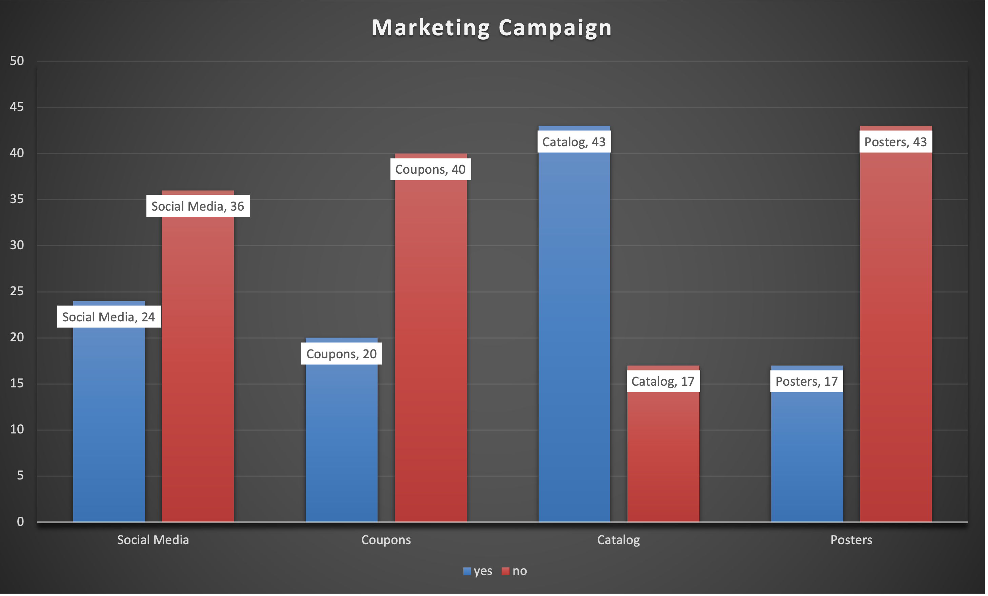
Best Marketing campaign

Slide 6

Account Sales Data for visualization
Total unit :
1,480,848
Total Accounts:
64
Largest Sales year:
2021
Best Campaign:
Catalog
Dashboard

Slide 7

Thank you

